Slide 1
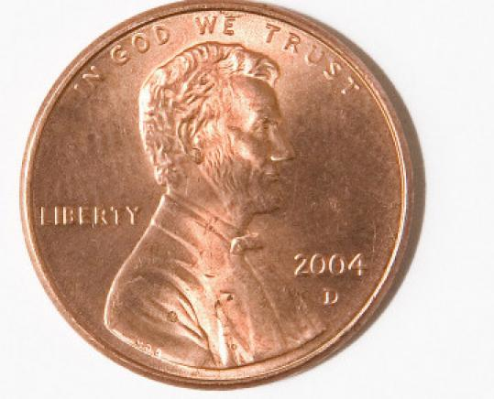
Penny Boat Challenge
By: Joseph Stabach

Slide 2
Archimedes’ Principle
The Archimedes' principle states that any object, wholly or partially immersed in a fluid, experiences an upward force equal to the weight of the fluid displaced by it.

Slide 3
The Challenge
Goals: Design a boat out of aluminum foil that will hold the most number of pennies and still stay afloat.
Objectives: Determine whether the surface area of the aluminum foil boat affects its buoyancy.
Materials: roll of aluminum foil, pennies, container, and tap water.

Slide 4
Rules
You each have been given a 14 in. by 10.25 in. piece of aluminum foil.
You may fold the foil any direction you like to create your boat.
You may not use tape or any outside objects to strengthen your boat.
Once your boat sinks, you are out. Count how many pennies your boat carries before sinking.

Slide 5
Think About It…
What shape will you mold your boat into?
Is it better to have your boat be short and thick or long and thin?
Will the velocity in which you place the pennies matter?

Slide 6
Pre-Boat Build
Predict how many pennies your boat will hold.
Each penny weighs 2.5 grams. How many grams will your boat hold if your prediction comes true?
What strategy will you be using when building the dimensions of your boat?

Slide 7
Analyzing Data
How many pennies did your boat hold?
How many grams did your boat hold? Remember each penny weights 2.5 grams
Was that amount more or less than your prediction?
Would you change the design of your boat if you did this activity over again? If so what would you change? If not, what would you leave the same?

Slide 8
Look at the boat from your group that was the most successful. Why do you think it was able to hold the most weight? What were some of the characteristics of that boat?

